Slide 1
Kings of Dominia
Alexander Schuster, Mengdi Wang ,
Mohamed Haddej, Alexander Epple

Slide 2

Trailer

Slide 3
Game Overview
Titel: Kings of Dominia
Platform: Android/iOS & Windows
Genre: Puzzle / Strategy
Rating: FSK 0
Target: Casual Gamer

Slide 4

High Concept& Unique Selling Points
Publisher:
Cheap to expand if successful (DLCs)
Player:
Unique game and concept
Cross platform (more options)
Almost no acquisition cost
Cross plattform (bigger market)
Better graphics than comparable games

Slide 5
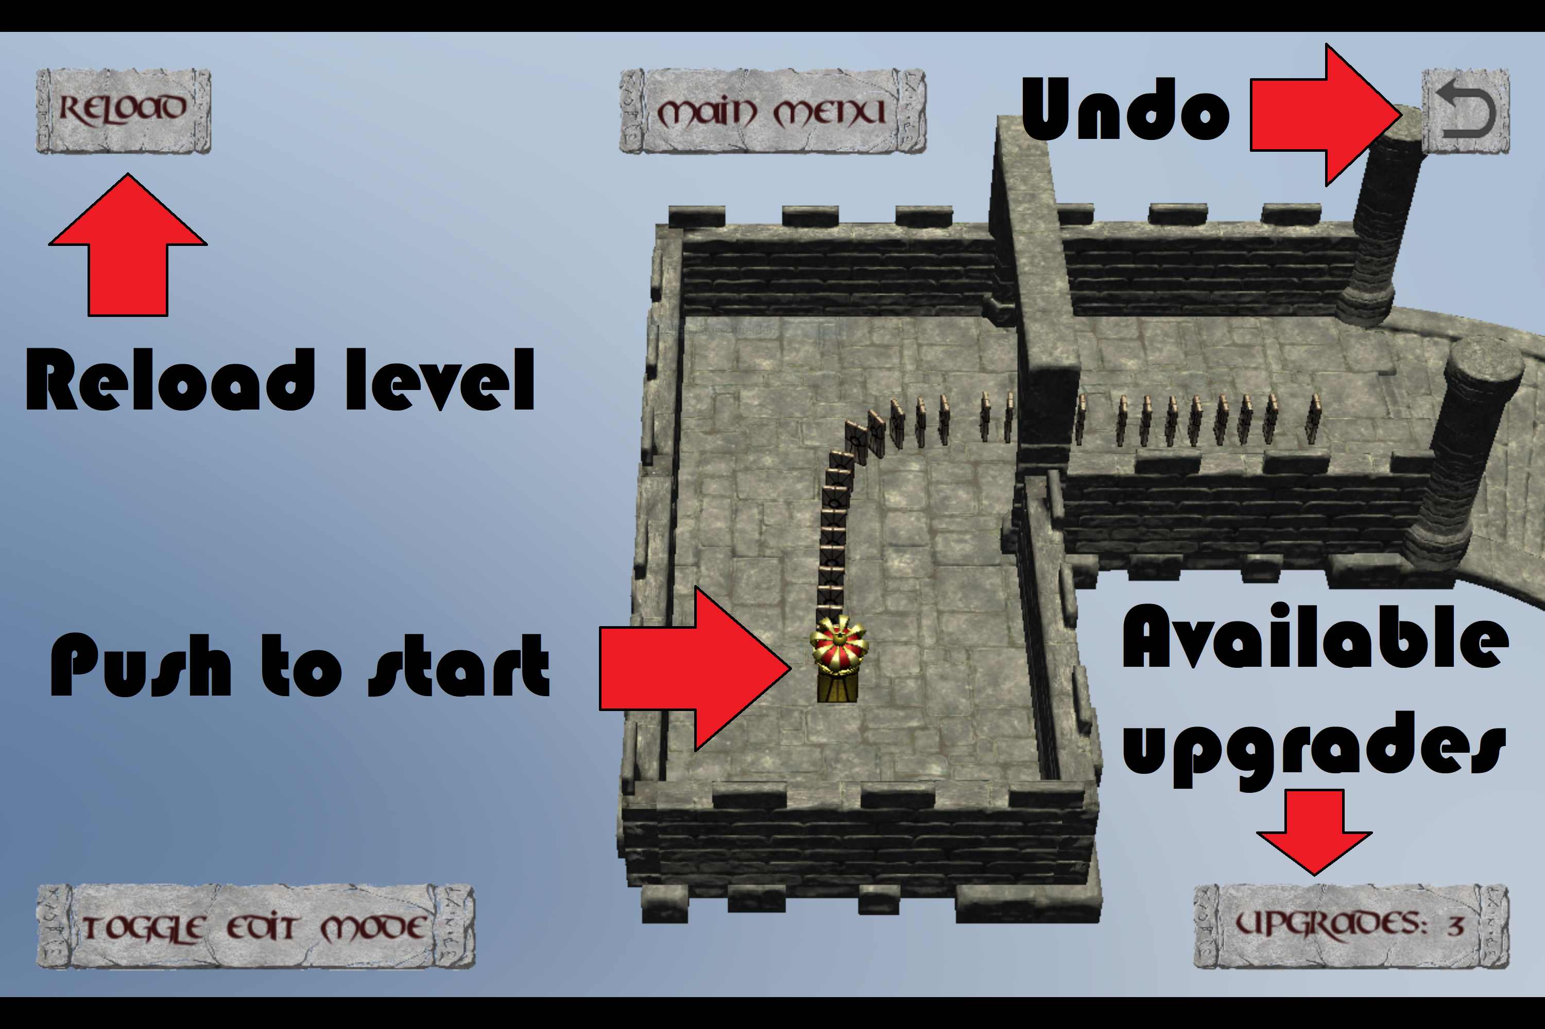
Game Overview

Slide 6
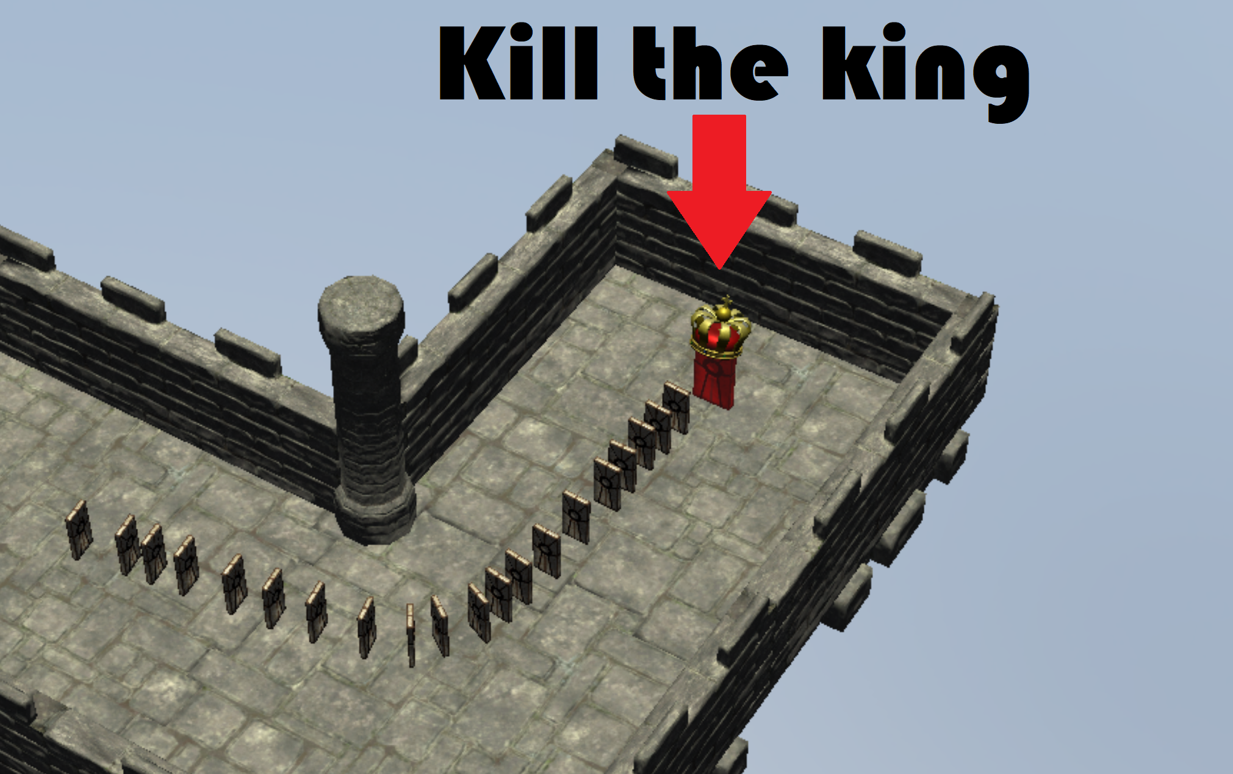
Game Overview

Slide 7
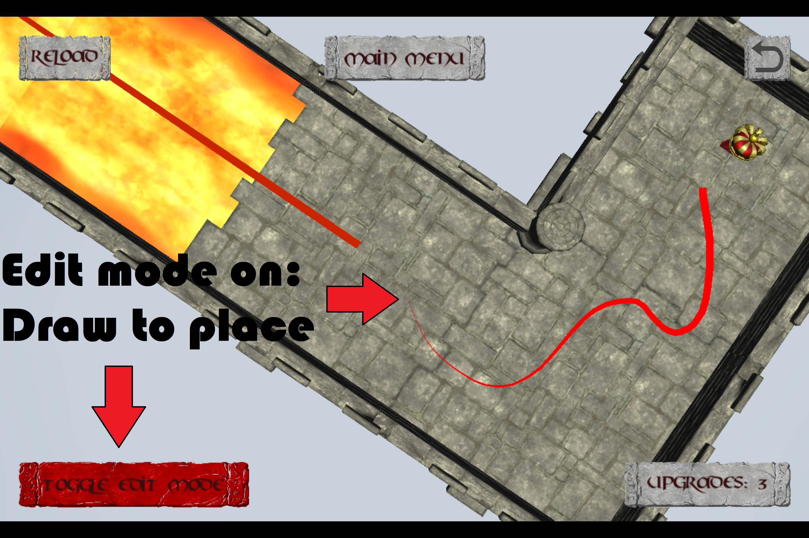
Game Overview

Slide 8
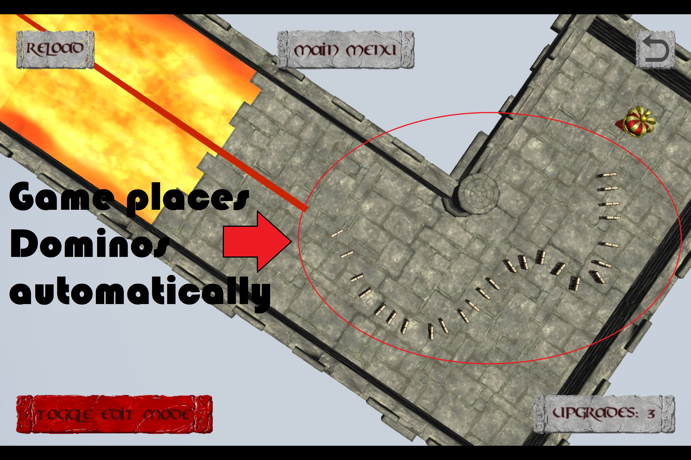
Game Overview

Slide 9
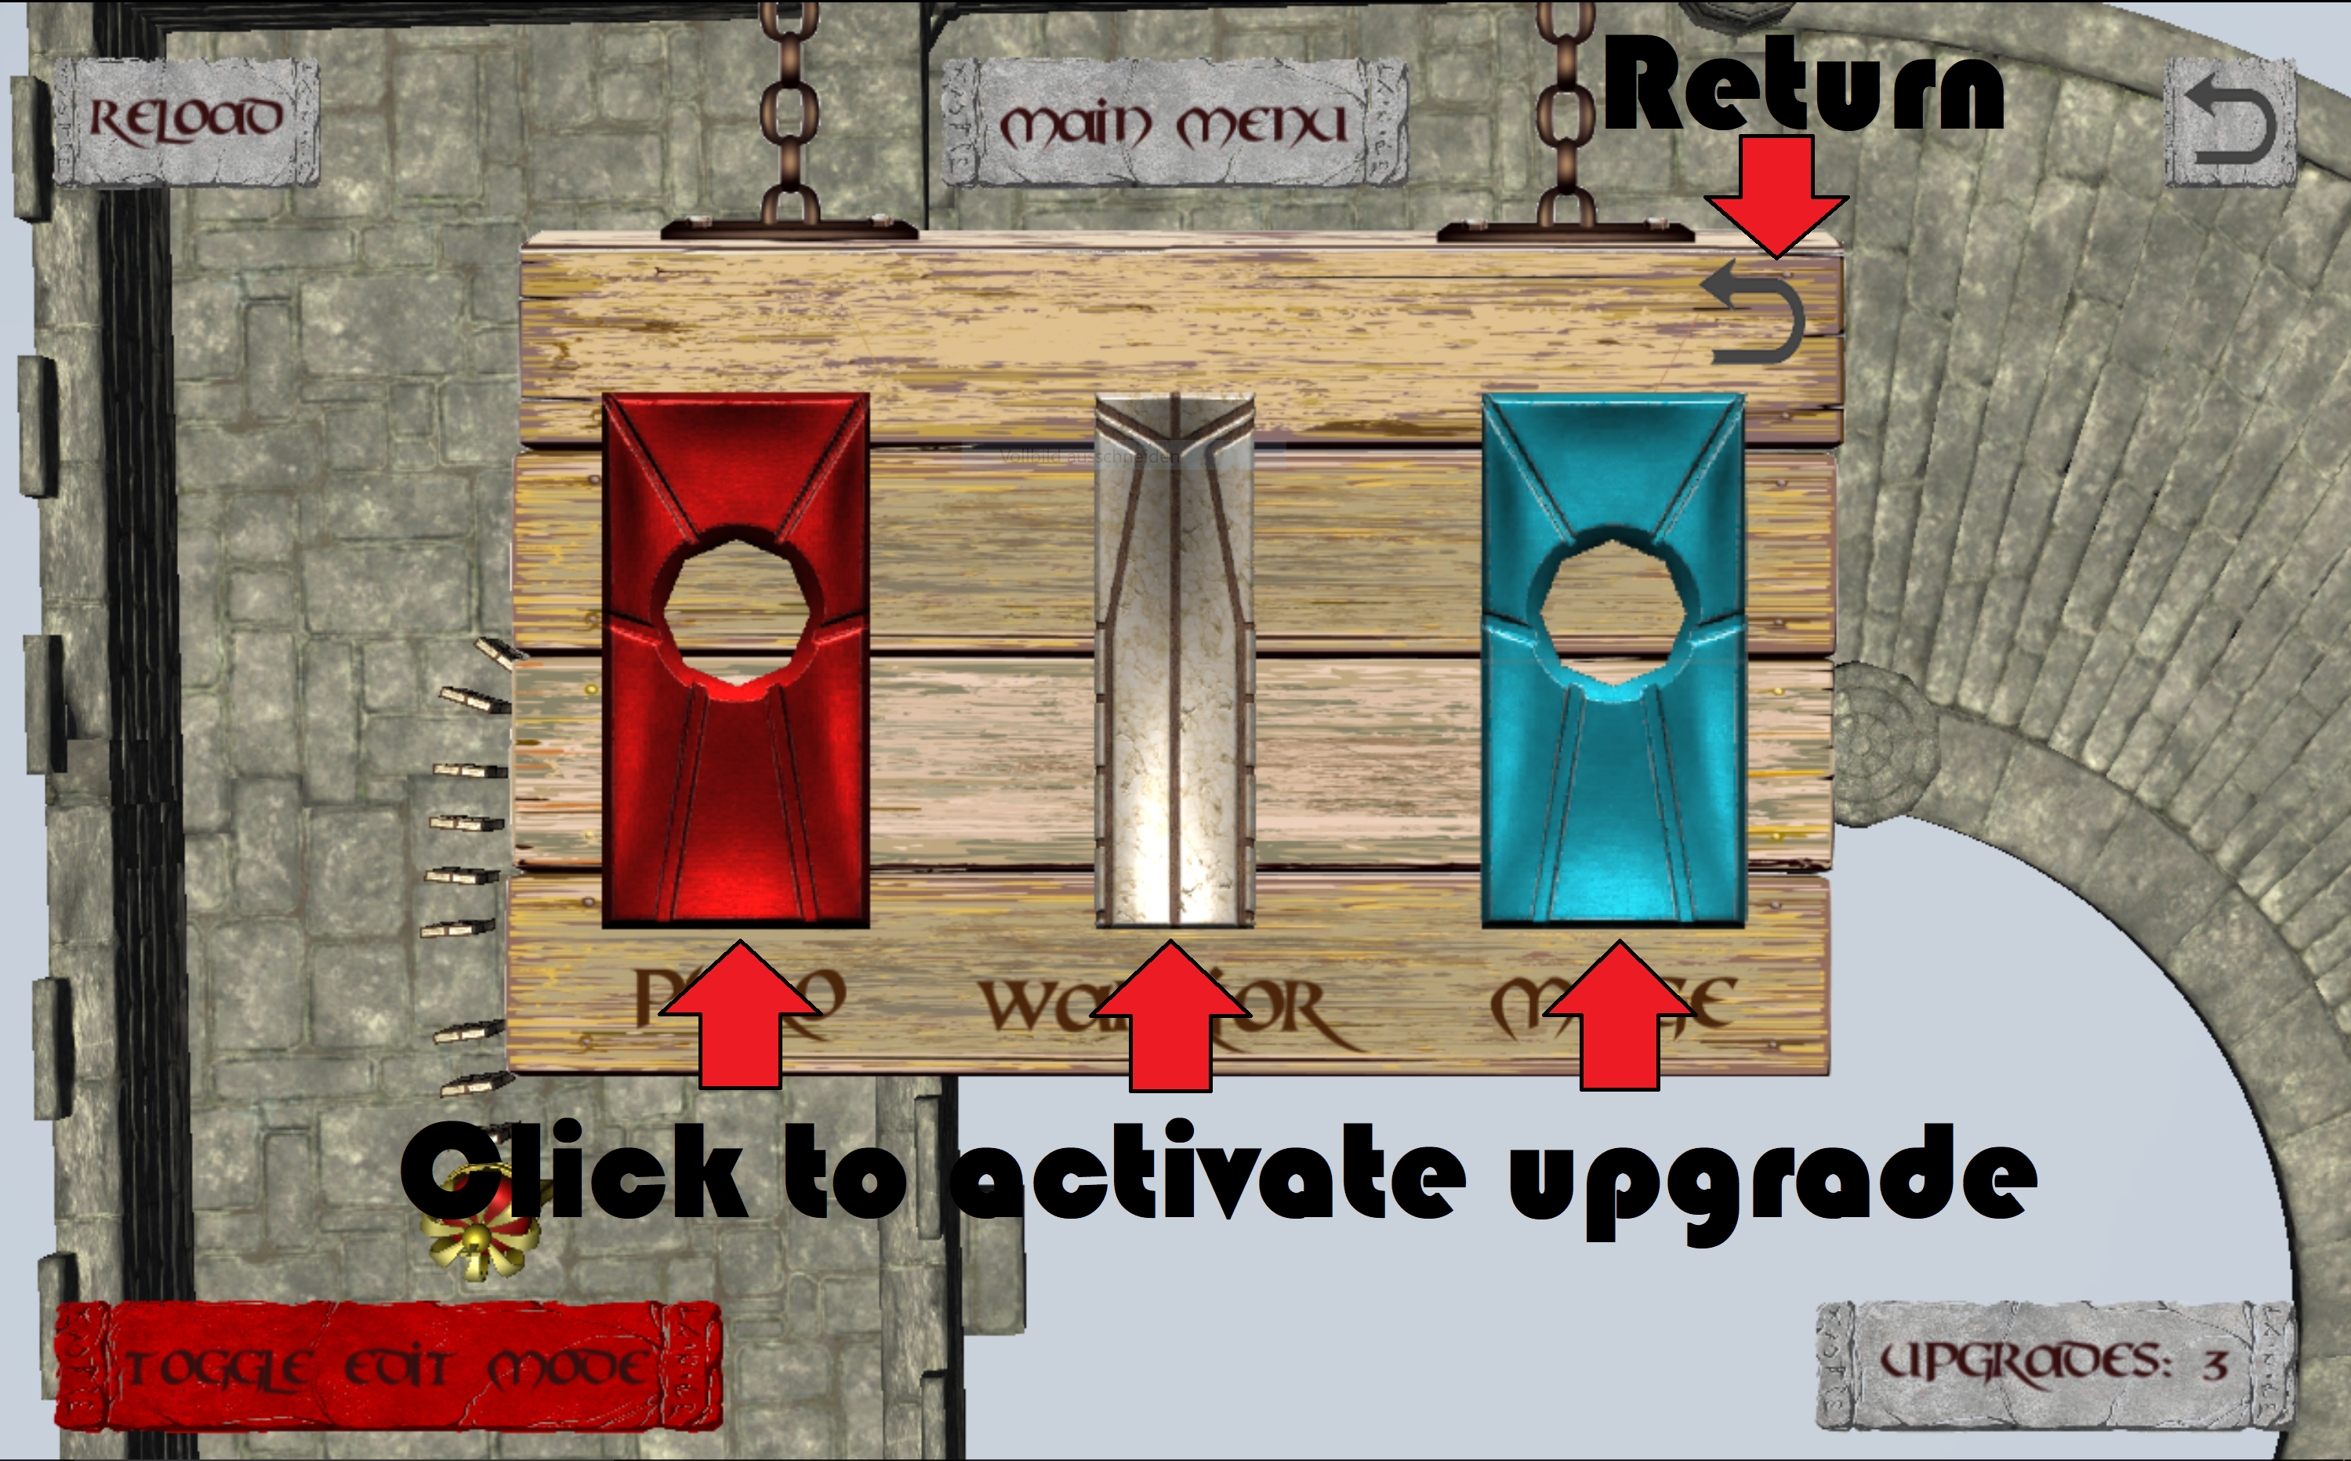
Game Overview

Slide 10
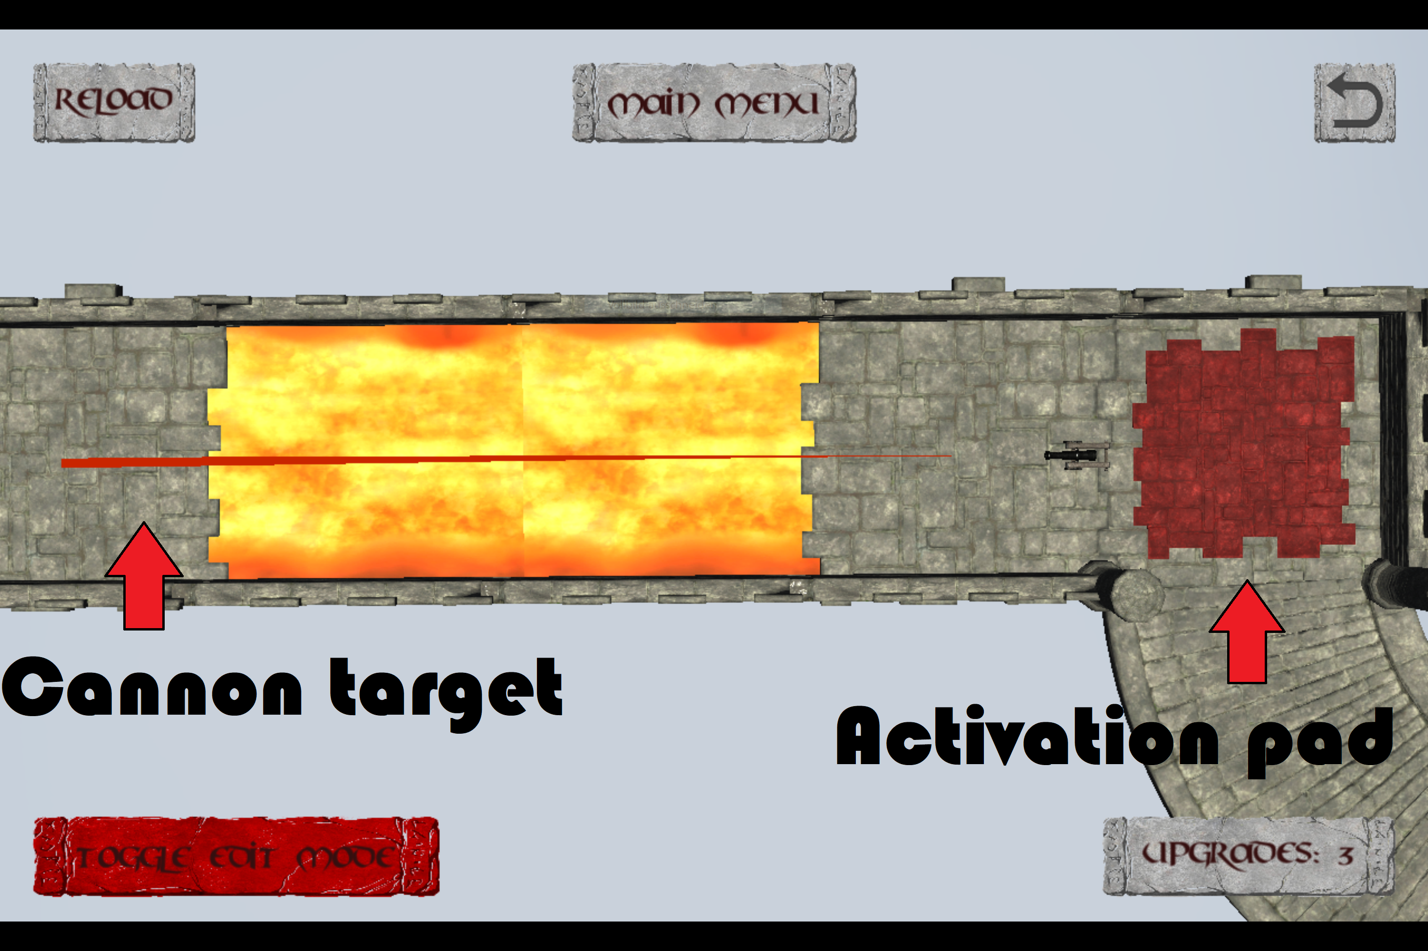
Game Overview

Slide 11
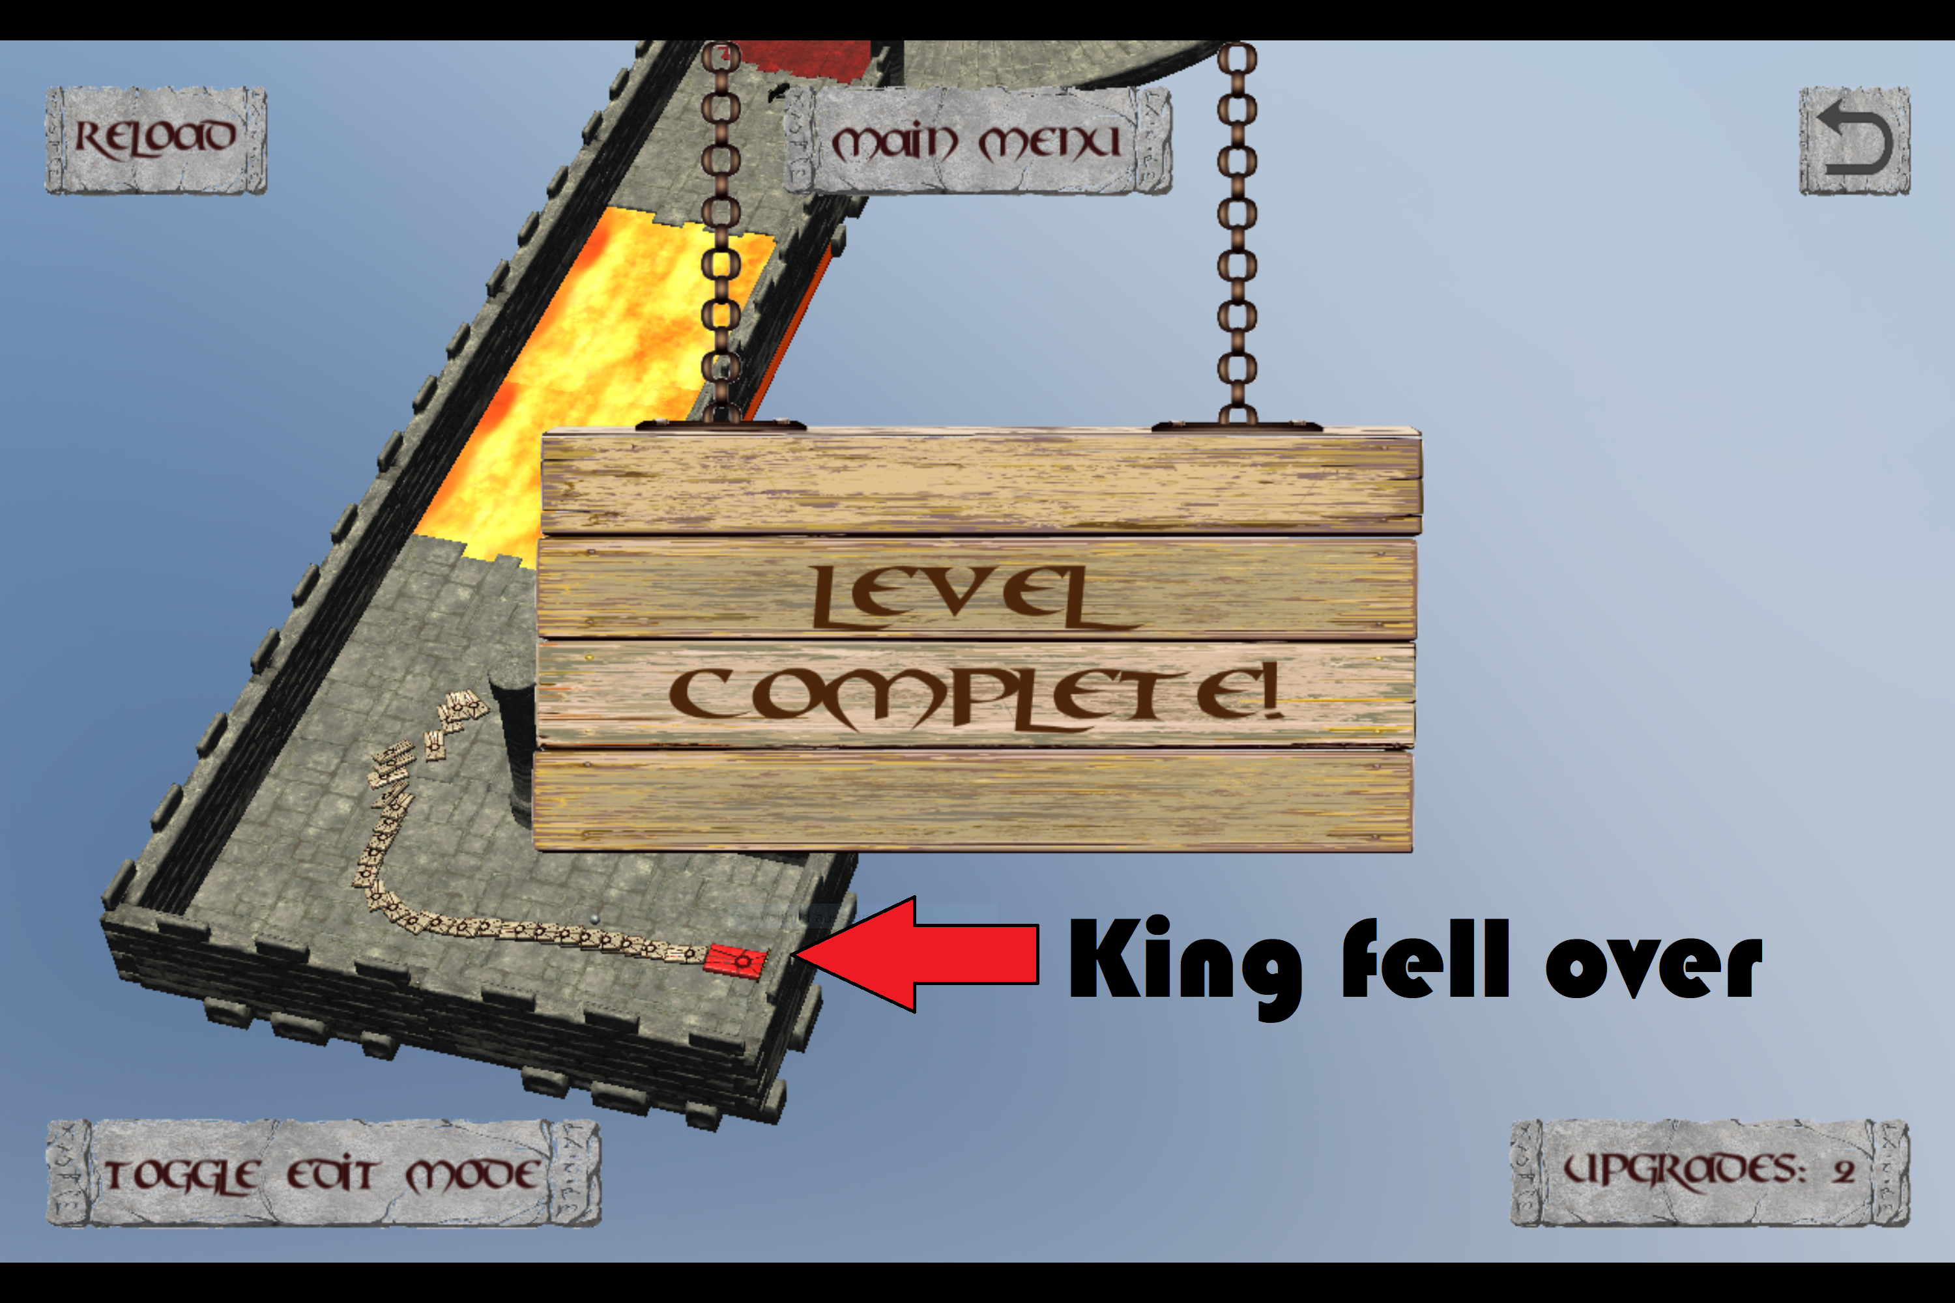
Game Overview

Slide 12
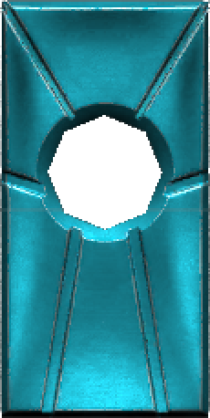
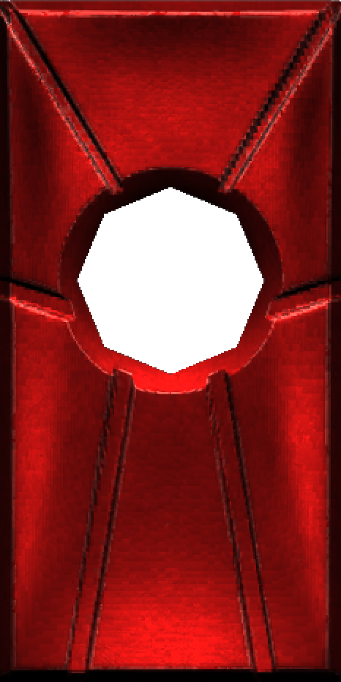
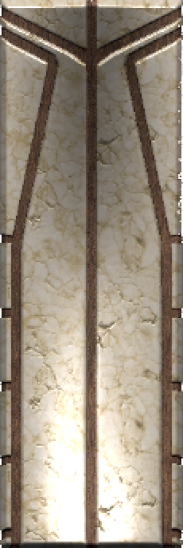
Stone Upgrades
Ice Mage
Pyro
Warrior

Slide 13
Project Plan Part 1: Work Division
 | Prototype | Presentation & Pitch
Alex E | Programming, Debugging | Game design, Story, Trailer
Alex S | Art Modelling | Cost, Break-Even, Marketing, Pricing
Mengdi | Programming, Debugging | Project Plan, Publishing, Trailer
Taieb | Sound Effect

Slide 14
Project Plan Part 2: Platform & Tools
Communication
Face-To-Face
Whatsapp
Discord
Prototype Platform
Unity
Source Control
Github

Slide 15

Project Plan Part 3: Time Estimation
Before our project starts…
 | Estimated Time | Deadline
Idea & Concept | 3 weeks | 20.11.2017 (4th Seminar)
Game Mechanic | 1 week | 27.11.2017 (5th Seminar)
First playable Level | 4 weeks | 24.12.2017 (Chrismas)
All Models added |  | 24.01.2018
All Sound Effect added |  | 24.01.2018
UI finished | 2 weeks | 24.01.2018
All Levels finished | 4 weeks | 25.01.2018
Game Build successful | 1 day | 26.01.2018

Slide 16

Project Plan Part 3: Time Estimation
When it really starts…
 | Finished Time | Overdue?
Idea & Concept | 27.11.2017 | Yes ☹
Game Mechanic | 28.11.2017 | Yes ☹
First playable Level | 05.12.2017 | No ☺
All Models added | 21.12.2017 | No ☺
All Sound Effect added | 22.01.2018 | No ☺
UI finished | 15.01.2018 | No ☺
All Levels finished | 21.01.2018 | No ☺
Game Build successful | 24.01.2018 | No ☺☺☺

Slide 17
Project Plan Part 4: Action List (real)
Action | Date | Notes
1. Team Set Up | 23.10.2017 | 1st Seminar
2. New Member | 06.11.2017 | 2nd Seminar
3. Kick-Off 1 | 27.11.2017 | Game Idea confirmed
4. Level Design | 16.01.2018 | Two more Level Designs
5. Trailer | 25.01.2018 | Trailer finished
6. Presentation | 06.03.2018 | Presentation finished

Slide 18
Project Plan Part 5: Milestones (real)
Milestones | Date | Notes
1. Kick-Off 2 | 28.11.2017 | Game mechanic confirmed
2. First Commit | 03.12.2017
3. New Models | 04.12.2017
4. First Test Level | 05.12.2017 | First playable Level
5. Domino Spawn | 07.12.2017 | Drag spawns Domino
6. Edit Mode | 15.12.2017
7. Line Renderer | 15.12.2017 | Spawn shows line
8. Camera Function | 17.12.2017
9. New Domino Type | 18.12.2017 | Ice Domino added

Slide 19
Project Plan Part 5: Milestones (real)
Milestones | Date | Notes
10. Reverse Mechanic | 18.12.2017 | Game Reverse Framework
11. Basic UI | 19.12.2017 | Primary UI added
12. Sound Effect | 21.12.2017
13. UI Refinement | 15.01.2018 | UI finished
14. New Domino Type | 17.01.2018 | Pyro Domino added
15. New Levels | 21.01.2018 | New Designs realized
16. Model Refinement | 22.01.2018 | All Models finished
17. Vibration | 24.01.2018 | Vibration added
18. Project Build | 24.01.2018 | Prototype finished! ☺

Slide 20
Project Plan Part 6: Future
Since our prototype is already finished,
what if we were to start as a real indie team right now?
Team Reinforcement ?
No need ☺
2 Programmers
1 Audio Engineer
1 Art Designer
Nice-To-Have: Assistant for Marketing & Publishing

Slide 21
Project Plan Part 6: Future
Imaginary Time Estimation (most likely)
 | Estimated Time
New Game Concept & Story | 1 week / maybe not
Game Mechanic Refinement | 2 weeks
Target Group Analysis | 1 week
First Test Level | 2 weeks
Game Design Refinement | Consecutive
First playable Beta Level | 4 weeks
All Levels playable | 4 weeks
Level Beatufication | 2 weeks
Total | 3.5 Months

Slide 22




Publishing & Sales Platform
Since it is a game focusing on mobile touchscreen device…
No special need for Publisher
But high demand to Sales Platform…
70% / 30%
+ 100 $
70% / 30%
???
(70% / 30%)
70% / 30%

Slide 23




Financing
We hope we can get financing from…
Crowdfunding
Support Program
Private Investor
Someone else?

Slide 24
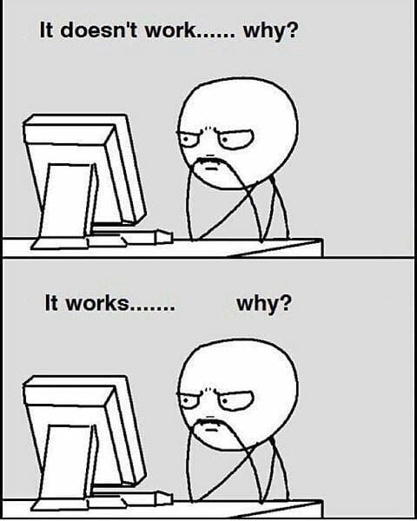
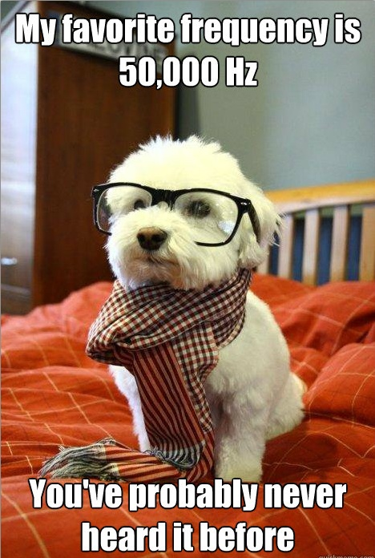
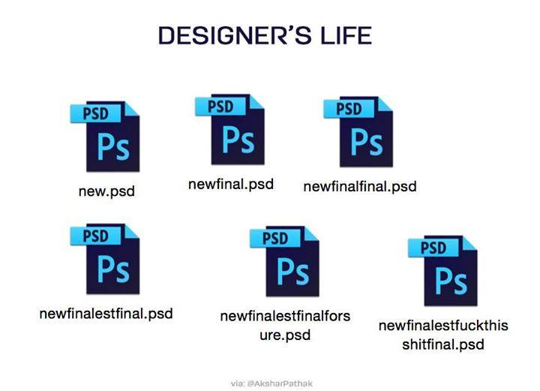
Costs
Fixed Cost Estimate
2x Programmer
1x Audio Engineer
1x Art Designer
Salary between 2900$ – 4000$. We take: 3.500$ x 4 = 14.000$ per month
Unity Plus: 35$ x 4 = 140$ per month

Slide 25
Costs
Jump Fixed Costs / Variable Costs
Synchronously speaker for story
External studio for skins and extra levels
Mac workstation
Apple developer account
Nice-To-Have

Slide 26
Costs
Time Assessment
Best Case | 2 Months
Most Likely | 3,5 Months
Worst Case | 6 Months
Time cost estimation: 1/6 x (2x2 + 3x6 + 3,5) = 4,25 months
Total fixed costs: 4,25 x 14.140$ = 60.095$

Slide 27
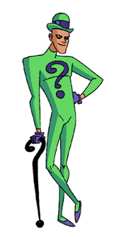
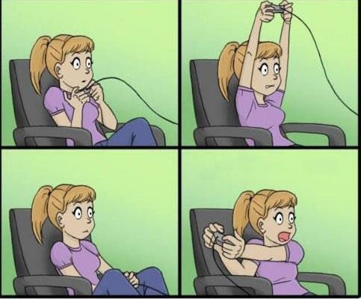
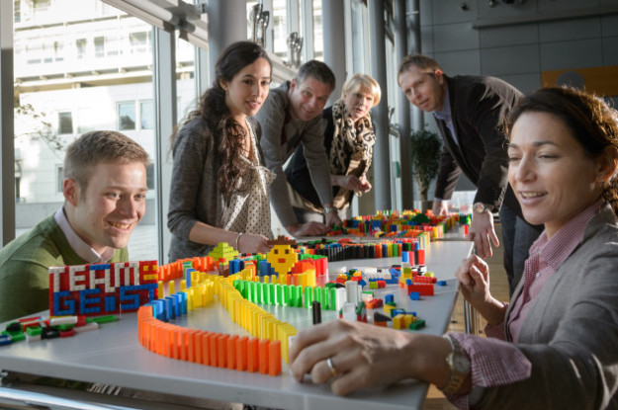
Marketing
Target Group
casual gamers
puzzle solvers
domino enthusiasts?
Challenge: appeal to both target groups

Slide 28
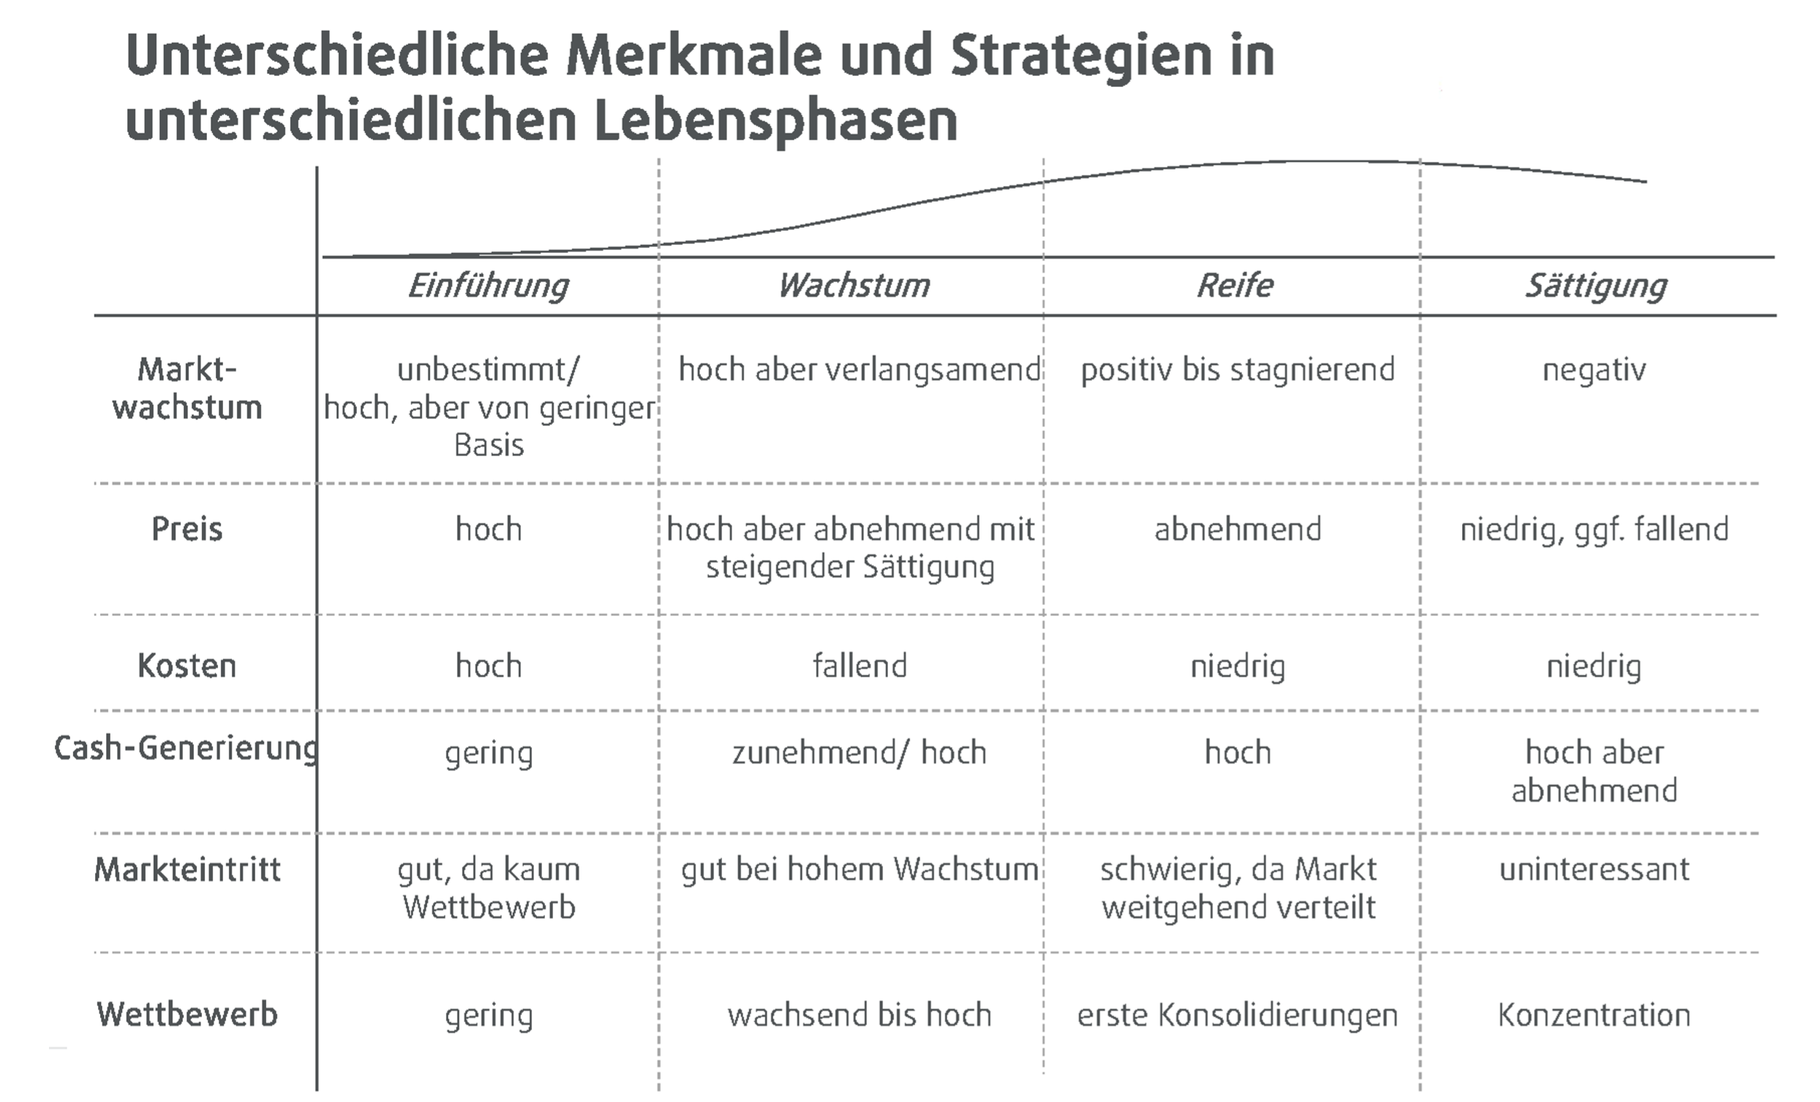
Marketing

Slide 29
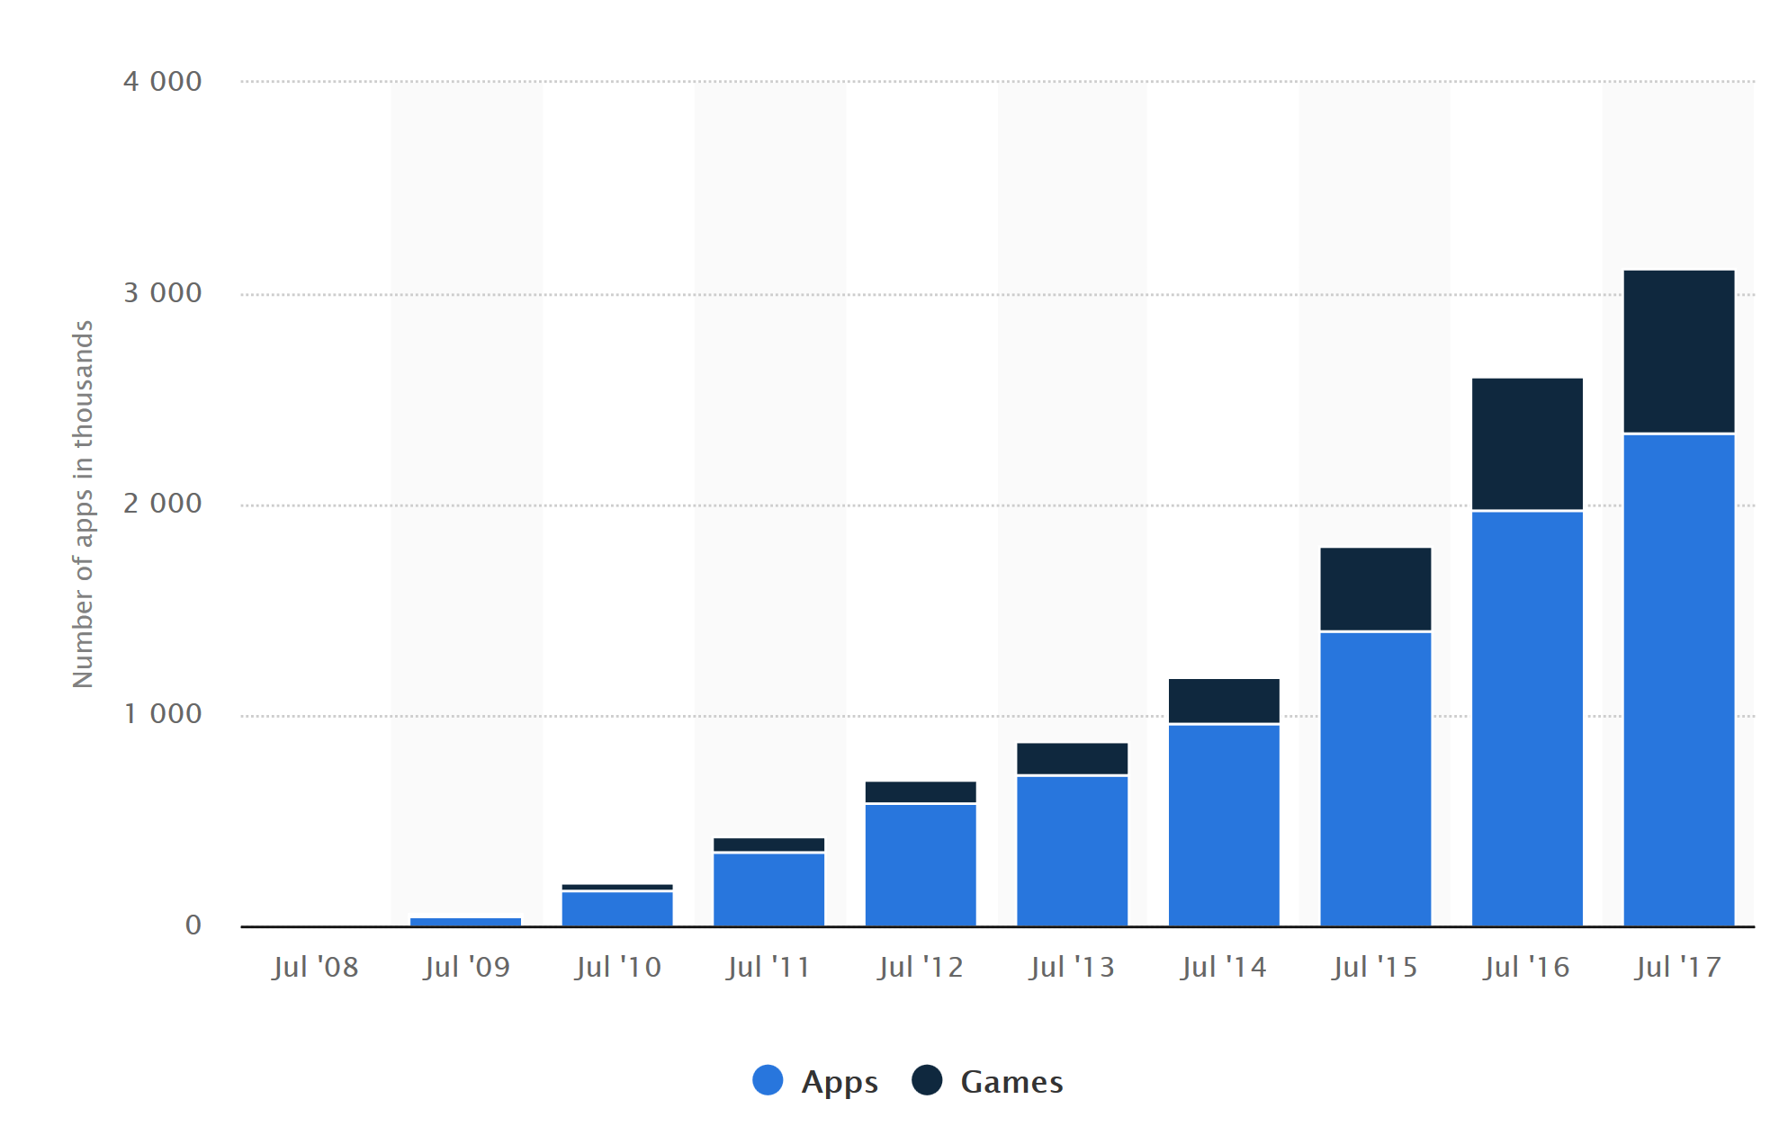
Marketing
Apple Appstore

Slide 30
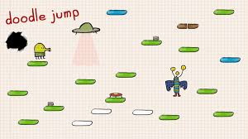
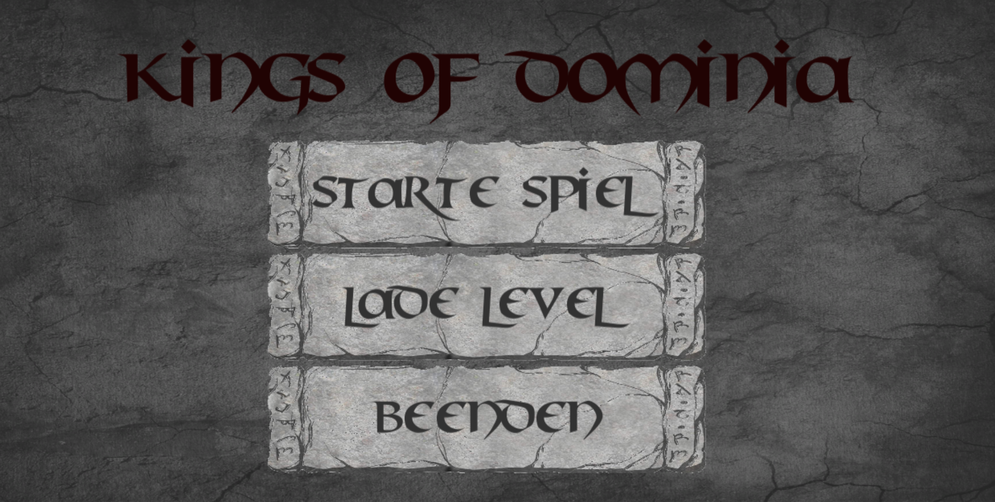
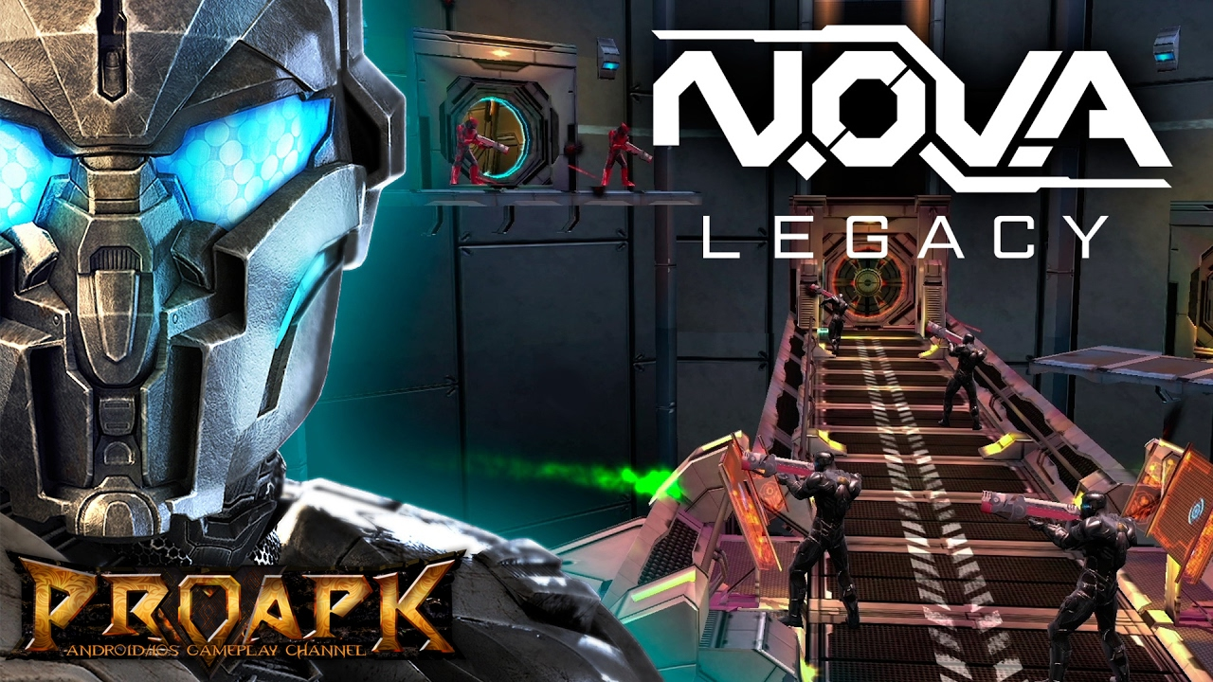
Costs
0,79$
2,99$
4,99-6,99$
Problem: many games are free to play

Slide 31
Break-Even
- Fixed costs
- Fixed costs (+20%)
units sold
-30% platform fee

Slide 32
Marketing Budget/Costs
Strengths + Weaknesses
extendability
high unit number to break-even
weak competition (genre)
target group hard to reach
graphics
High marketing costs to generate enough reach
Strategy:
Universal app campaign
Youtube advertisment
High daily rates upon release

Slide 33
Thank you for your attention!
Any questions?

